Slide 1

CRASH DETECTIVES
Analyzing Accidents
Toronto 2006-2020

Slide 2

INTRODUCTION
Toronto ranks 47th in the most congested cities in the world, 8th in North America and 2nd in Canada.
In Canada, annually there are about 165,000 accidents with 10,000 seriously injured and 2,000 killed. These accidents costs society $37 billion (2.2% of Canadian GDP) annually.

Slide 3
OUR AGENDA/GOAL
The goal of this project is to investigate and determine what causes accidents and what attributes to their level of severity.
Through visualizations and machine learning algorithms, areas of concern will be highlighted, and the seriousness of accidents will be predicted as accurately as possible.

Slide 4



WHO DOES THIS PROJECT BENEFIT?
City Planners
Insurance Companies
Public
Accurately analyzing accidents can help governments to better the safety of their roads and highways.
It can also be beneficial to insurance companies looking to change their rates in different areas.
Identifying high areas of accidents and high areas of accident severity can highlight areas of concern.

Slide 5

RESEARCH QUESTIONS
Time of accident Impacts
Factors contributing to fatal accidents
Impacts of Red Light cameras on severity
Predicting accident fatalities

Slide 6

HYPOTHESIS
The null hypothesis is that red light cameras on have no impact on crash severity.
The alternate hypothesis is red light cameras reduce accident severity.

Slide 7
HYPOTHESIS
The null hypothesis is that red light cameras on have no impact on crash severity.
The alternate hypothesis is red light cameras reduce accident severity.

Slide 8
HYPOTHESIS
The null hypothesis is that red light cameras on have no impact on crash severity.
The alternate hypothesis is red light cameras reduce accident severity.

Slide 9
DATA SET
Not for presentation
City of Toronto's Open Data Portal- https://open.toronto.ca/dataset/
Seriously injured/killed collisions data : https://open.toronto.ca/dataset/motor-vehicle-collisions-involving-killed-or-seriously-injured-persons/
Red light cameras data :
https://open.toronto.ca/dataset/red-light-cameras/
Traffic collision data :
https://open.toronto.ca/dataset/motor-vehicle-collisions-involving-killed-or-seriously-injured-persons/
Killed & Seriously Injured Data Details
Accident Number
Road Class
Collector
Accident Location
Intersection
Location
Visibility
Expressway and ramps
Lane
Local
Major + minor arterials with ramps
Latitude
Longitude
Driveway
Overpass or bridge
Underpass or tunnel
Trail
Private driveway…
Clear
Fog, mist, smoke and dust
Freezing rain
Snow and Drifting snow
Strong wind…
Light
Daylight or dark
Dawn or dusk
Artificial lights…
Vehicle type
Manoeuvre
Automobile and station wagon
Motorcycle
Bicycle
Driver Action
Pick up truck
Street Car
School bus…
Turning left or right
Failed to yield right of way
Disobeyed traffic control
Lost control
Improper lane change
Speed too slow
Speed too fast for condition…
Stopped
Making U-turn
Overtaking
Changing lanes
Reversing …
Age of the involved
10 to 14
25 to 29
Over 95
15 to 19
20 to 24
……
Driver condition
Ability impaired, alcohol
Normal
Inattentive
Medical/physical disability
Fatigue
Ability impaired, drugs…
Accident class
Fatal
Non-fatal injury
Property damage
Time stamp
Year
Date
Time
Accident Identifier

Slide 10
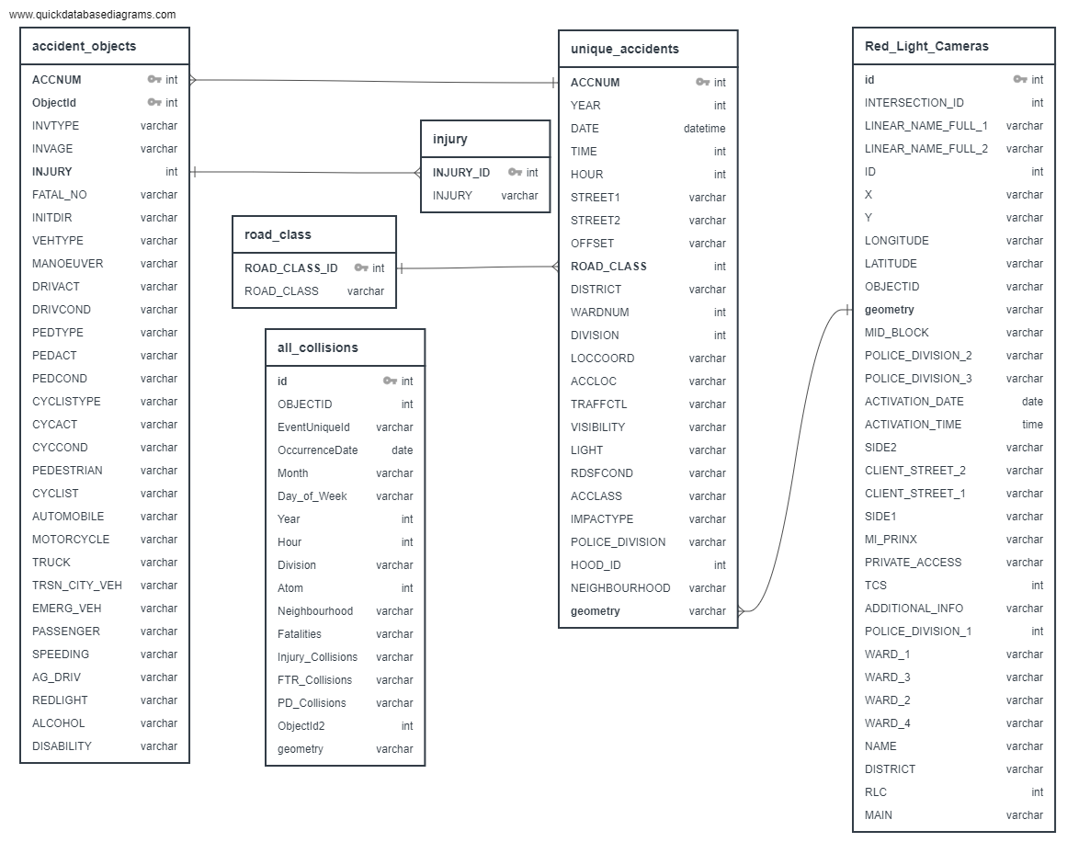
E
R
D

Slide 11
EXPLORATORY DATA ANALYSIS
More Fatal accidents in areas without Red Light
More accidents happen in the beginning of Summer and Winter
Weekends are more dangerous. Fridays are worse.

Slide 12




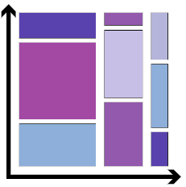
Exploratory Data Analysis Process
Data cleaning
Visualization
Removing Redundant variables
Variable Selection, Data Types
Remove outlier
Creating Charts, Graphs
1
2
3
4
5
Import
Correlation
Algorithm model
Import libraries
Load data in data frames
Finding Relationship between variables
Use information from EDA for your Model

Slide 13
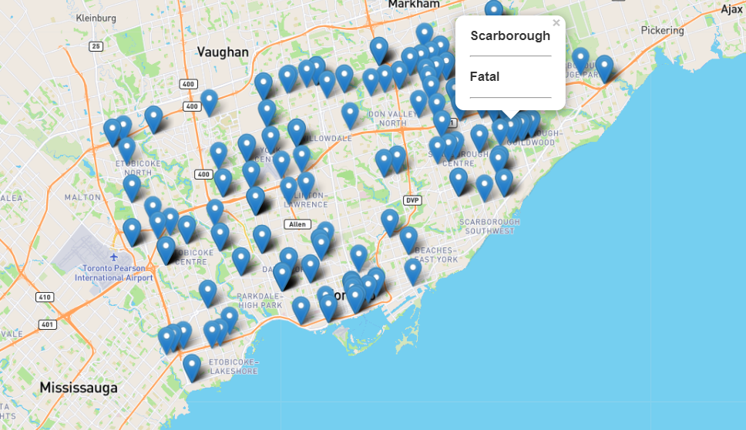
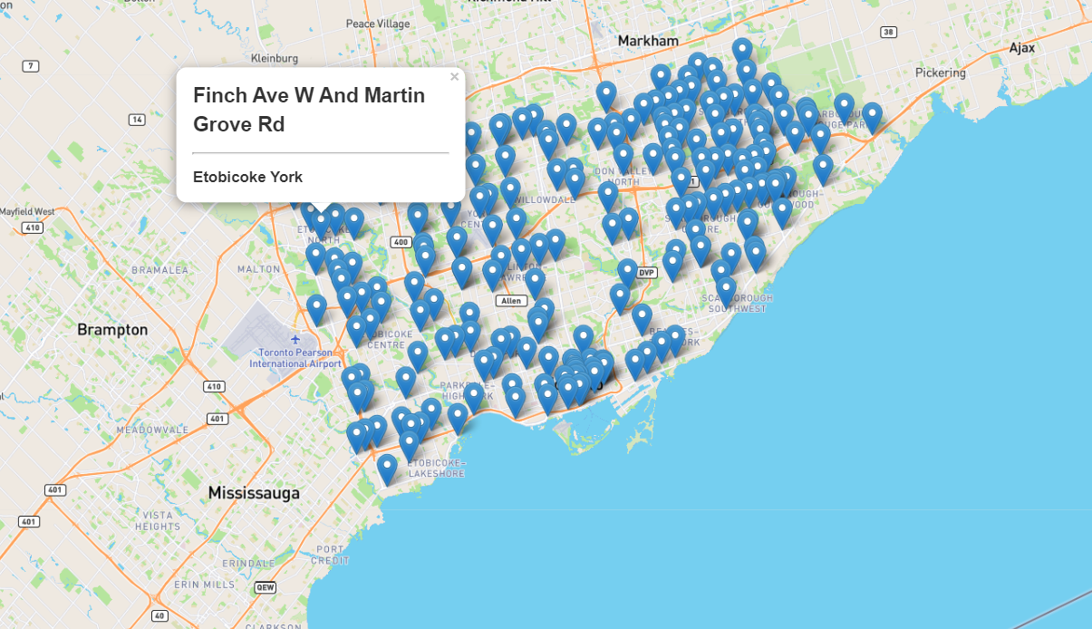
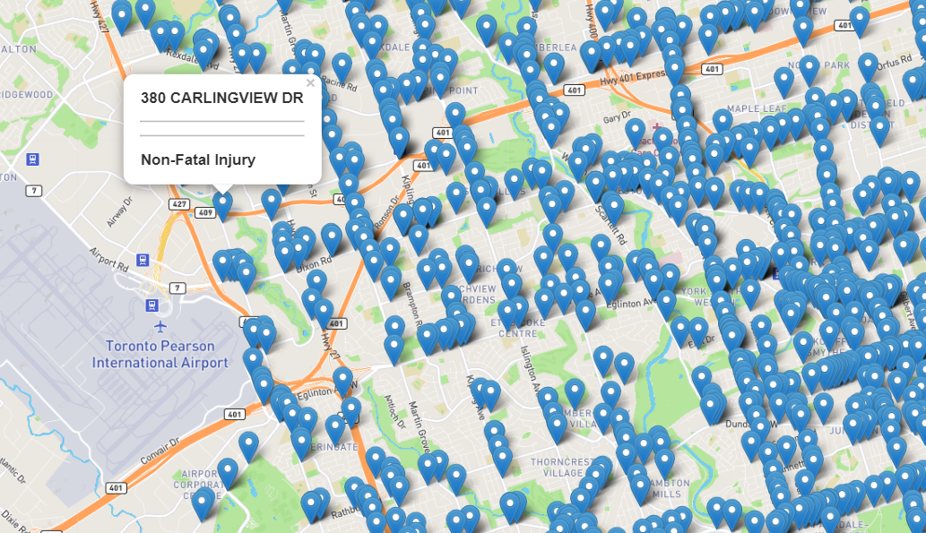
Accidents @ Red Light Camera Locations - Low Density
Red Light Camera Locations
Accidents @ Locations Without Red Light Camera - High Density

Slide 14
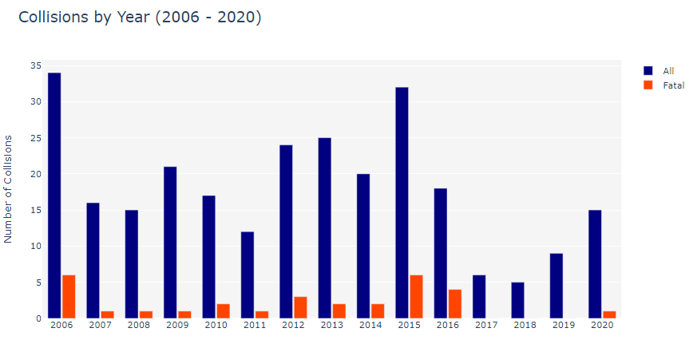
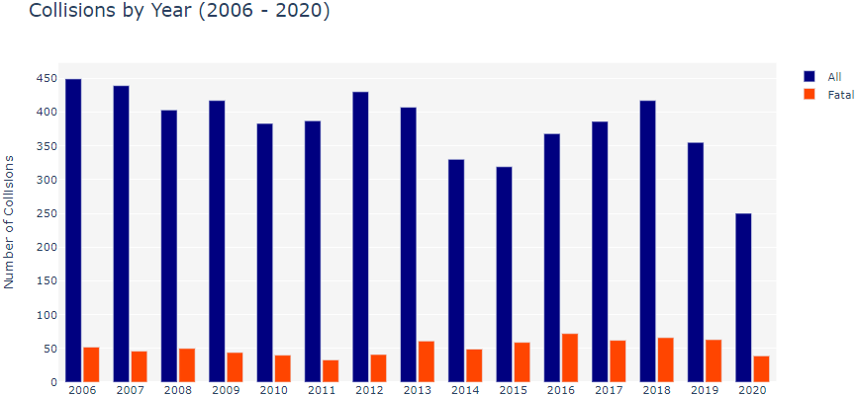
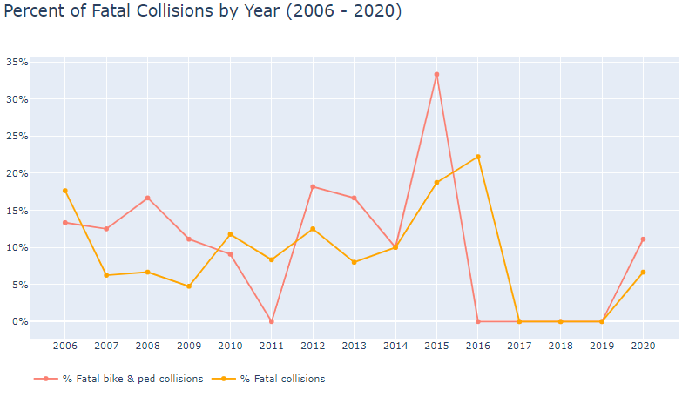
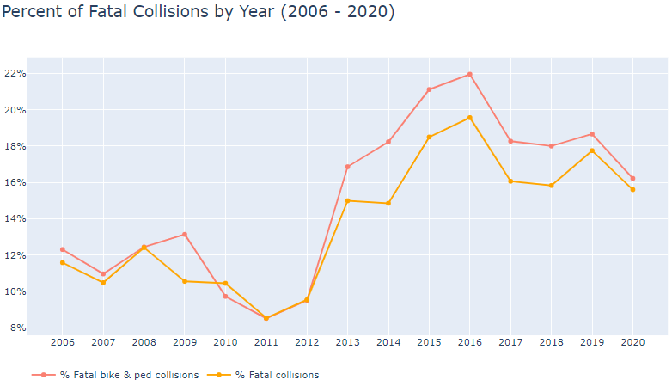
Collisions by Year with Red Light Camera
2006-2020
Collisions by Year without Red Light Camera
2006-2020
% of Fatal Collisions by Year with Red Light Camera
2006-2020
% of Fatal Collisions by Year without Red Light Camera
2006-2020

Slide 15
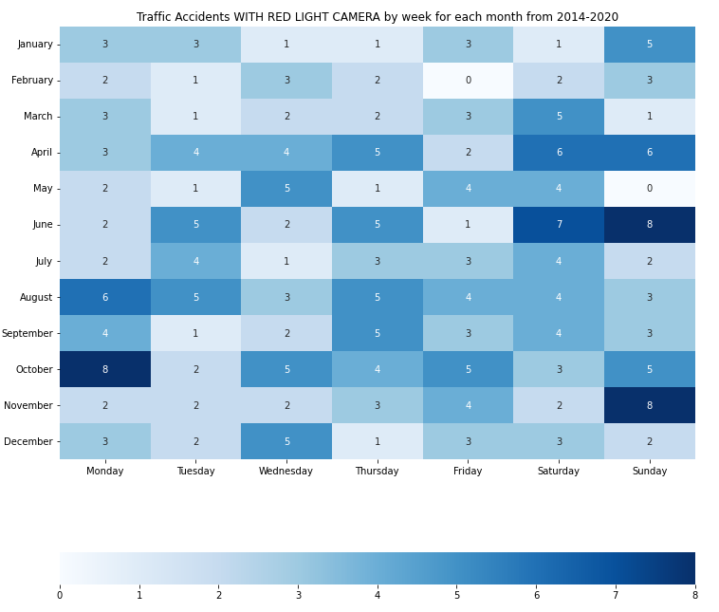
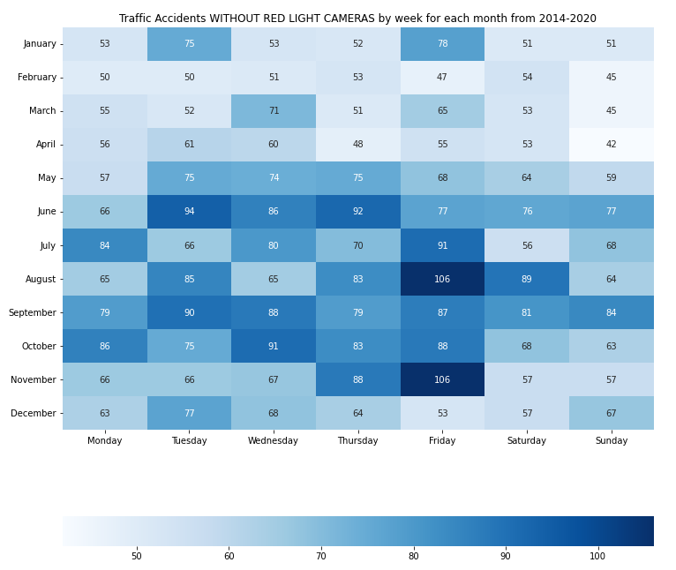
Traffic Accidents with Red Light Camera
by month & week 2014 - 2020
Traffic Accidents with without Red Light Camera
by month & week 2014 - 2020

Slide 16
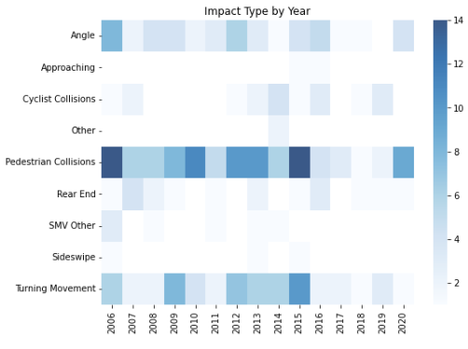
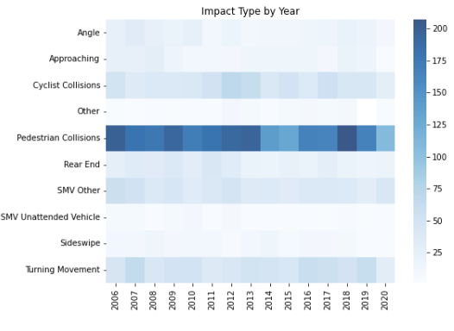
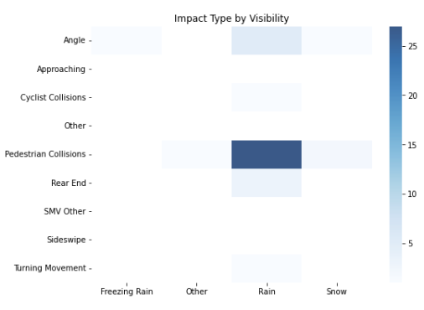
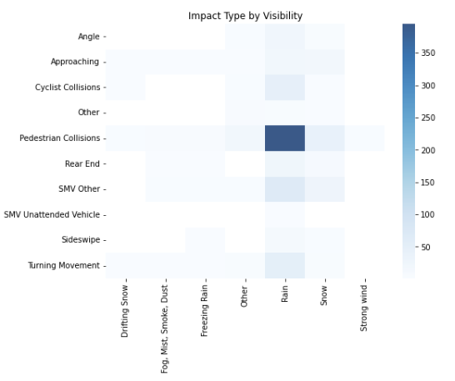
Impact Type by Year with Red Light Camera ‘06 – ‘20
Impact Type by Year no Red Light Camera ‘06 – ‘20
Impact Type & Visibility with Red Light Camera ‘06 – ‘20
Impact Type & Visibility no Red Light Camera ‘06 – ’20

Slide 17
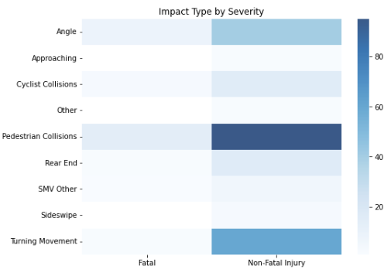
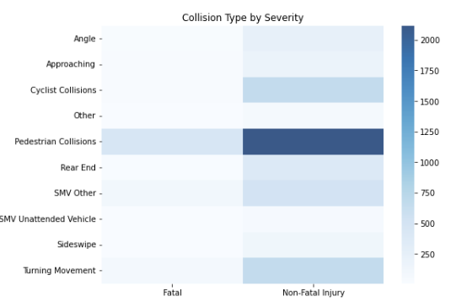
Impact Type by Severity at Red Light Camera
Impact Type by Severity no Red Light Camera

Slide 18
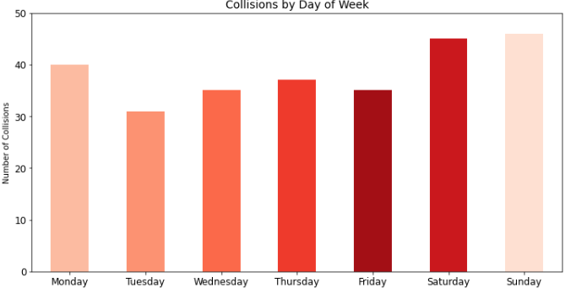
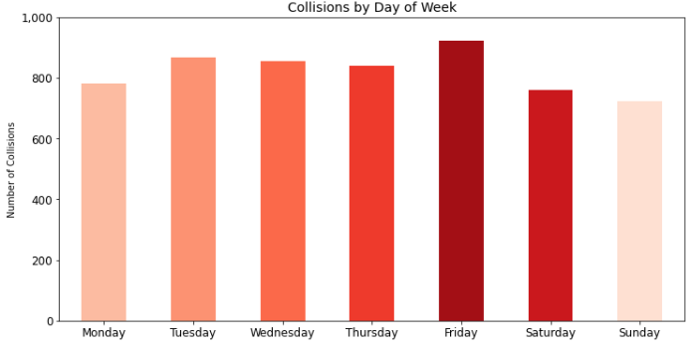
Collisions by day of week at Red Light Camera
Collisions by day of week no Red Light Camera

Slide 19
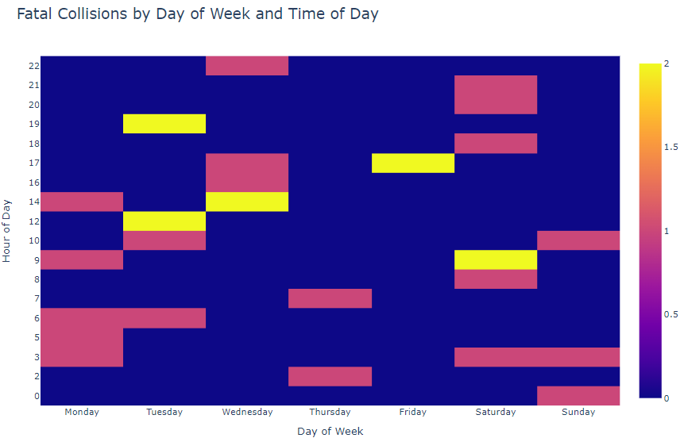
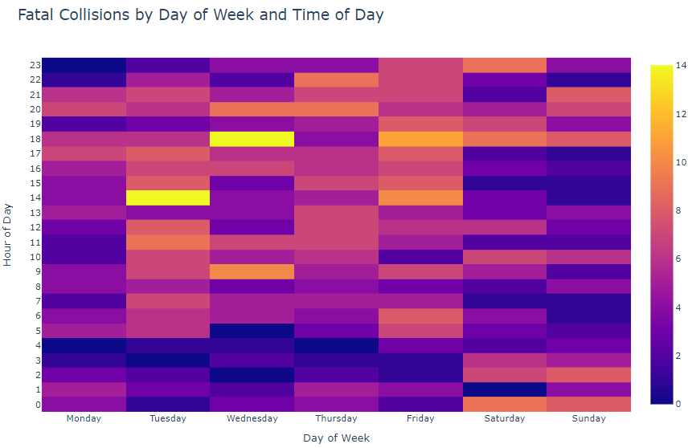
Fatal Collisions by day of week at Red Light Camera
Fatal Collisions by day of week no Red Light Camera

Slide 20


TECHNOLOGIES USED
Data cleaning &
exploratory analysis
Database storage
Machine learning models
Dashboard
Pandas, numpy,
seaborn
Database storage:
PostgreSQL
Decision tree
Random forest
Gradient boosting
Tableau public

Slide 21
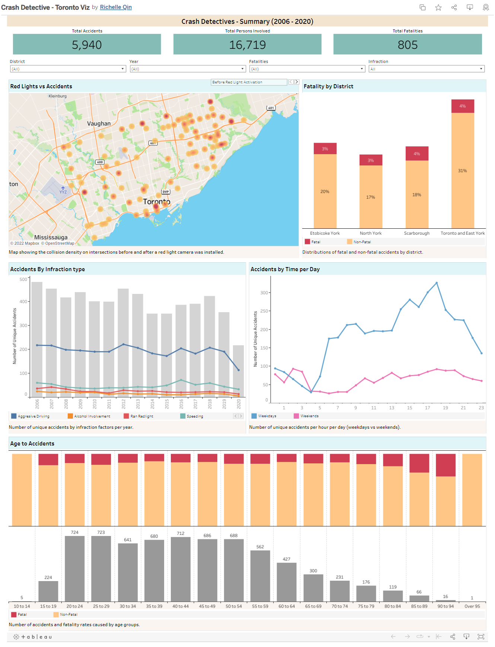
DASHBOARD
Access Dashboard HERE

Slide 22

Machine Learning

Slide 23
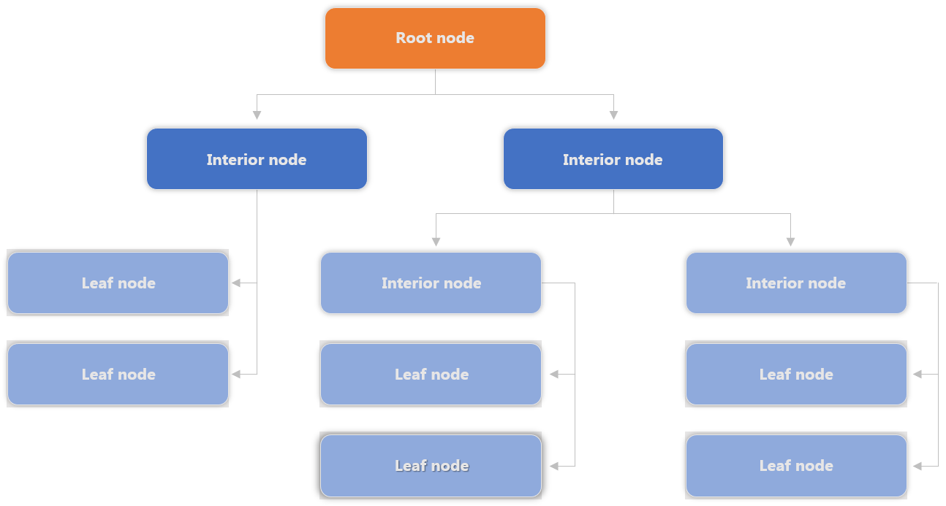
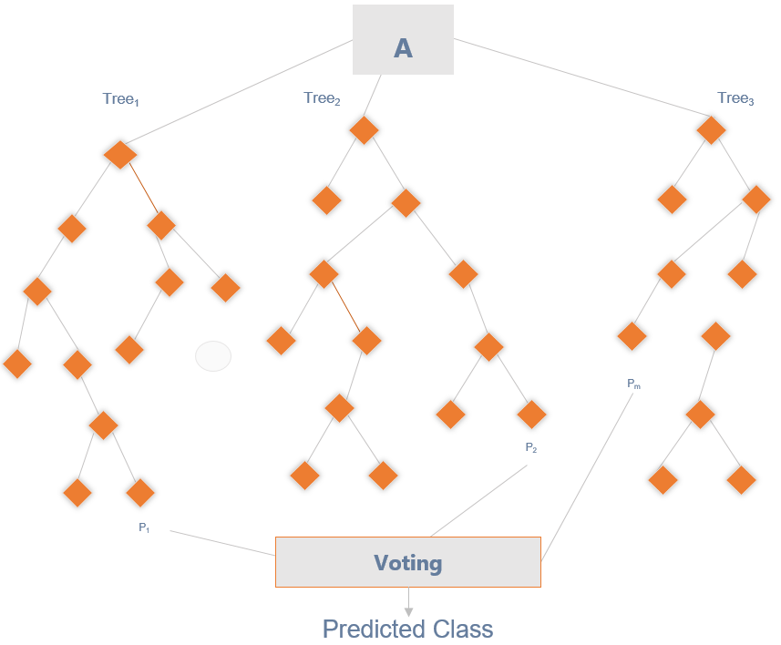
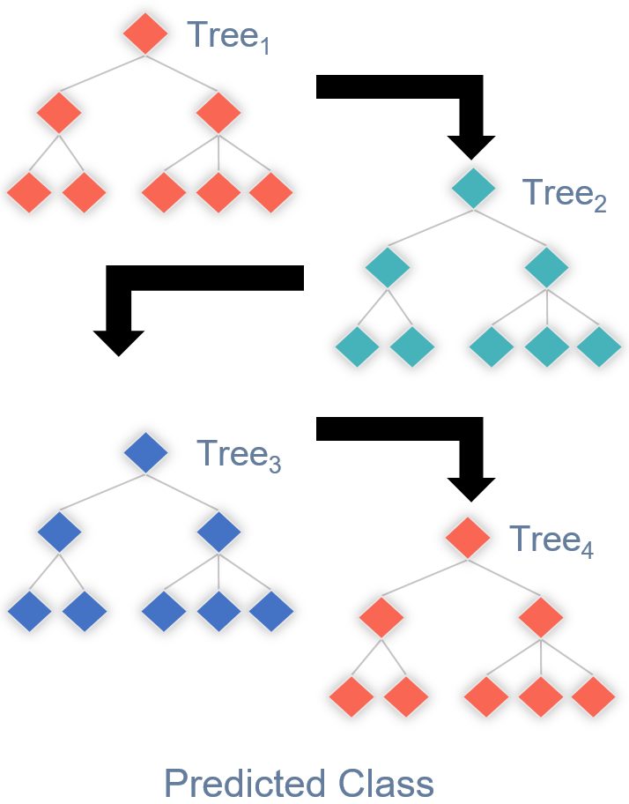
Models Options
Decision Tree
Random Forest
Gradient Boost
Benefits: An easy interpretive model. Easy to classify or label objects.
Drawbacks: It can become very large very quickly. Deep and complex trees tend to overfit to the data and does not generalize well.
Benefits: A random forest algorithm will sample the data and build several smaller, simpler decision trees. Has a reduced risk of overfitting.
Drawbacks: The main limitation of random forest is that a large number of trees can make the algorithm too slow and ineffective for real-time predictions. In general, these algorithms are fast to train, but quite slow to create predictions once they are trained.
Benefits: Works well with unbalanced classes. Boosting also can improve model predictions for learning algorithms. The weak learners are sequentially corrected by their predecessors, and, in the process, they are converted into strong learners.
Drawbacks: Sensitive to outliers since every classifier is obliged to fix the errors in the predecessors.
Notes:
Random Forest
As we know where the cameras are already installed, we will use the factors of the accidents at those locations to train our model to predict the location of red-light cameras based on the factors of traffic accidents. As there are many factors that affects a collision in an intersection, using a random forest enables feature randomness when building individual trees, to which the forest will make a more accurate prediction by committee.
Gradient Boosting
As major and more severe collisions occur infrequently compared to the whole scope of collisions, the model we build may hold some form of bias and skewness. In other words, the random forest may produce predictions solely on the factors that affect minor collisions. This would mean the false negatives could be locations where major accidents had occurred, and the camera could be impacting such collisions. Thus, we will also test and employ gradient boosting. Gradient boosting will weight the observations and put more weight on the major collisions and less on minor collisions as they will already be handled well during training. This should reduce the bias and skewness of the model.

Slide 24

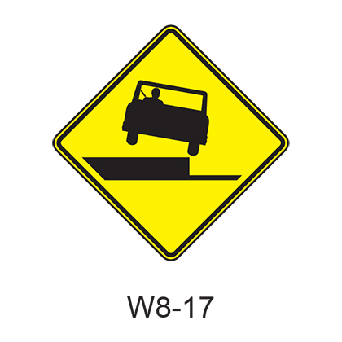
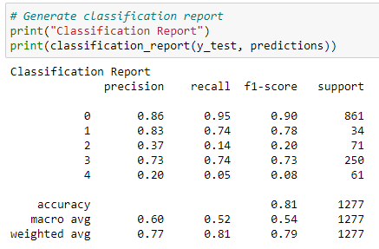
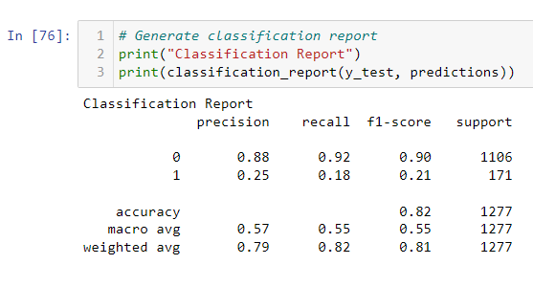
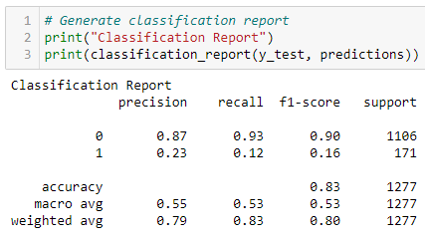
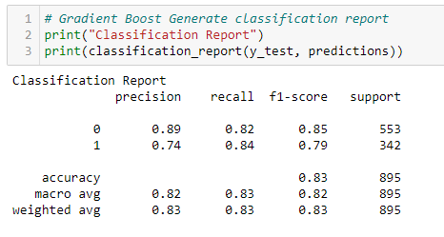
Machine Learning Process
Step
Step
Step
Step
Step
Run models with all data with injury type target
Target Accident Class
Refine Change encoding
Refine Remove Features
Success Use Over & Under-sampling
Results indicate over fitting and unclear results. Need to rethink the target. Pivot to use Accident Class.
Continued with label encoding. High F1, precision & recall on Non-Fatal predictions. Poor Fatal predictions.
Dig-in and make changes to remove any bias in the category encoding switch to one hot encoding from Label encoding
Remove features related to driver and focus on overall accident features
Correct class imbalance by over sampling fatalities and under sampling non-fatal accidents
Notes:
https://www.entrepreneur.com/article/253169

Slide 25
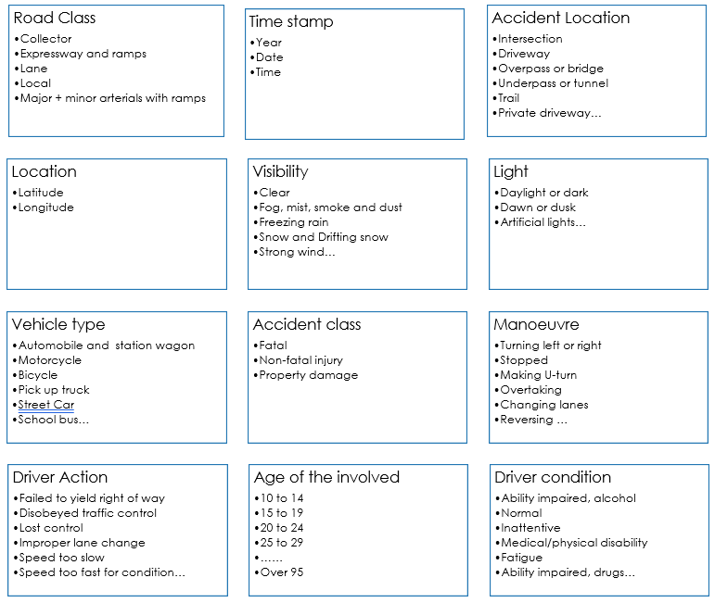
Machine Learning Process
The first stage involved keeping the majority of features with a few exceptions where the data could not be defined.
The data definitions for each raw file are found in the dataset folder
The models were pre-selected and include:
Random Forest
Gradient Boosted Tree
A size for the split into training and testing sets was not specified and therefore defaults to 25% with scikit-learn. Using Train_size or test_size the split can be specified.
The net result of this first run produced good performance on 3 of the 5 targets.
Step

Slide 26
Machine Learning Process
This initial ML model run in step 1 was muddled. The some of the features were specific to the person involved in the accident and some of the features applied to the overall accident.
At this stage feature selection became very important. A decision was made to only run the model based on overall accident features and exclude individual participant features.
The target changed from Injury type (specific to the person) to Accident Class (specific to the accident)
Classification report shows High F1, precision & recall on Non-Fatal predictions however the model performs poorly on Fatal predictions.
Step

Slide 27
Machine Learning Process
+
Step
Step
Refinement
These steps involved making additional decisions:
Based on feature importance rankings additional features which had no impact on results were dropped.
The encoding method was changed from Label Encoder to One Hot Encoder because some categorical columns had a high number of categories. This change ensured there was no ranking of the values because everything is a 1 or a 0 instead of a numerical range
Classification report shows no real improvement over step 2. There is still a high F1, precision & recall score on Non-Fatal predictions however the model performs poorly on Fatal predictions.

Slide 28

Machine Learning Process
Class imbalance was having a big impact on the ML model performance where it was being skewed by the high number of non-fatal records
To correct for this over sampling and under sampling was employed through trial and error and included:
Randomly extracting 50 records of each target and running the ML
Under-sampling the non-fatal records
Over-sampling the fatal accidents
The best result was doubling the fatal records and cutting in half the non-fatal records.
Success at last…
The F1 scores on both fatal and non-fatal predictions is high
Precision and recall are equally good
Step

Slide 29
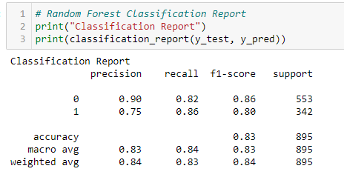

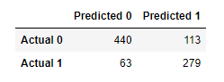
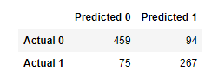

Results
Random Forest
Using the Model to Make Predictions
1
10 Intersection at 6pm
2
Input Speeding variable as Yes or No
3
Result: 6 out of the 10 intersections predict fatalities
Gradient Boost
Decision: Install Redlight camera or other controls
4
5
Iterate on other features to predict
outcomes

Slide 30






Outcomes
Expectations |  | Actual Outcome
Weather would have an impact on the number of collisions and severity |  | Most accidents occurred in the weather was clear and the roads dry
Alcohol and running red lights would be the highest factors leading to accidents and severity |  | There were very low/high correlations among these features and accident severity.
Accidents are more likely to occur at night |  | Accidents are more likely during rush hour 7-9am & 3-6pm
Red light cameras reduce accidents |  | Analysis shows this is true
Road class has no impact |  | Results show that Major Arterial roads have the most accidents
Drivers or passengers are more likely to be injured |  | Discovered Pedestrians are the most likely to be injured or killed of all involved

Slide 31
FUTURE ENHANCEMENTS
Traffic volume information
Distracted driving data
Speed limit data
Improve the All Traffic data file to contain the same features as the Killed & Seriously injured data.

Slide 32


The Team
ADITI
BARDHONIA
KRITIKA
RICHELLE

